Slide 1
The Influence of US foundation on Universities in Africa.
Towards an Anglicized World?
Fabrice Jaumont, PhD
Fondation Maison des Sciences de l’Homme, Paris
April 15, 2019 – CIES
SAN FRANCISCO

Slide 2
Sub-questions:
Do African universities have ownership over their participation in U.S. foundations’ strategies for Africa?
What legitimizes the role of U.S. foundations in African higher education?
Can U.S. foundations embrace Africa's development on Africa's terms?
Notes:
This raises many significant questions:
Can U.S. foundations embrace Africa's development on Africa's terms?
Do African universities have ownership over their participation in U.S. foundations’ strategies for Africa?
What legitimizes the role of U.S. foundations in African higher education?

Slide 3
DATA
American philanthropies made 13,565 grants to Africa between 2003 and 2013
330 US private foundations made grants totaling $3.9 billion in support of African initiatives
Grants focused on agriculture, health, higher education and research.
Notes:
American philanthropies made 13,565 grants to Africa between 2003 and 2013
330 US private foundations made grants totaling $3.9 billion in support of African initiatives
Grants focused on agriculture, health, higher education and research.

Slide 4
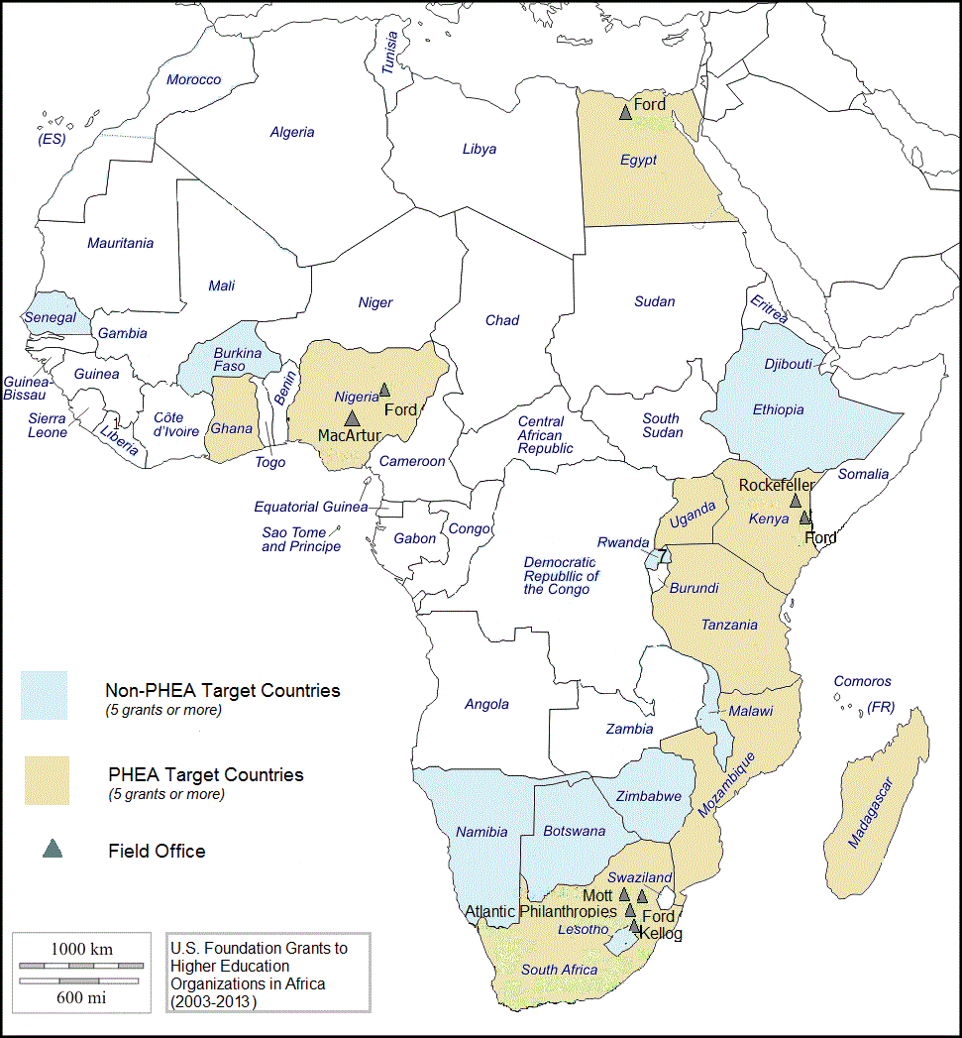
GEOPOLITICAL STRATEGIES OF U.S. FOUNDATIONS
between 2003 and 2013
97 U.S. foundations invested $573.5 million in institutions of higher education in Africa.
1,471 grants were made to 439 higher education institutions in 29 countries.
68% of all funding went to 3 countries (South Africa, Kenya , Nigeria)
Past colonial lines emerge as demarcations between Africa’s new knowledge societies

Slide 5
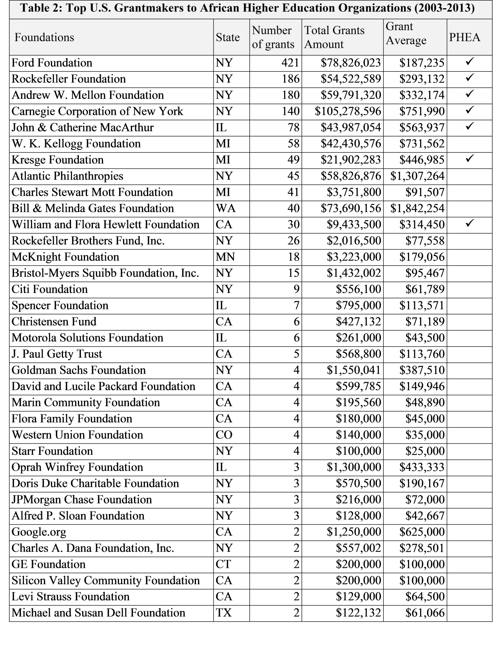

Slide 6
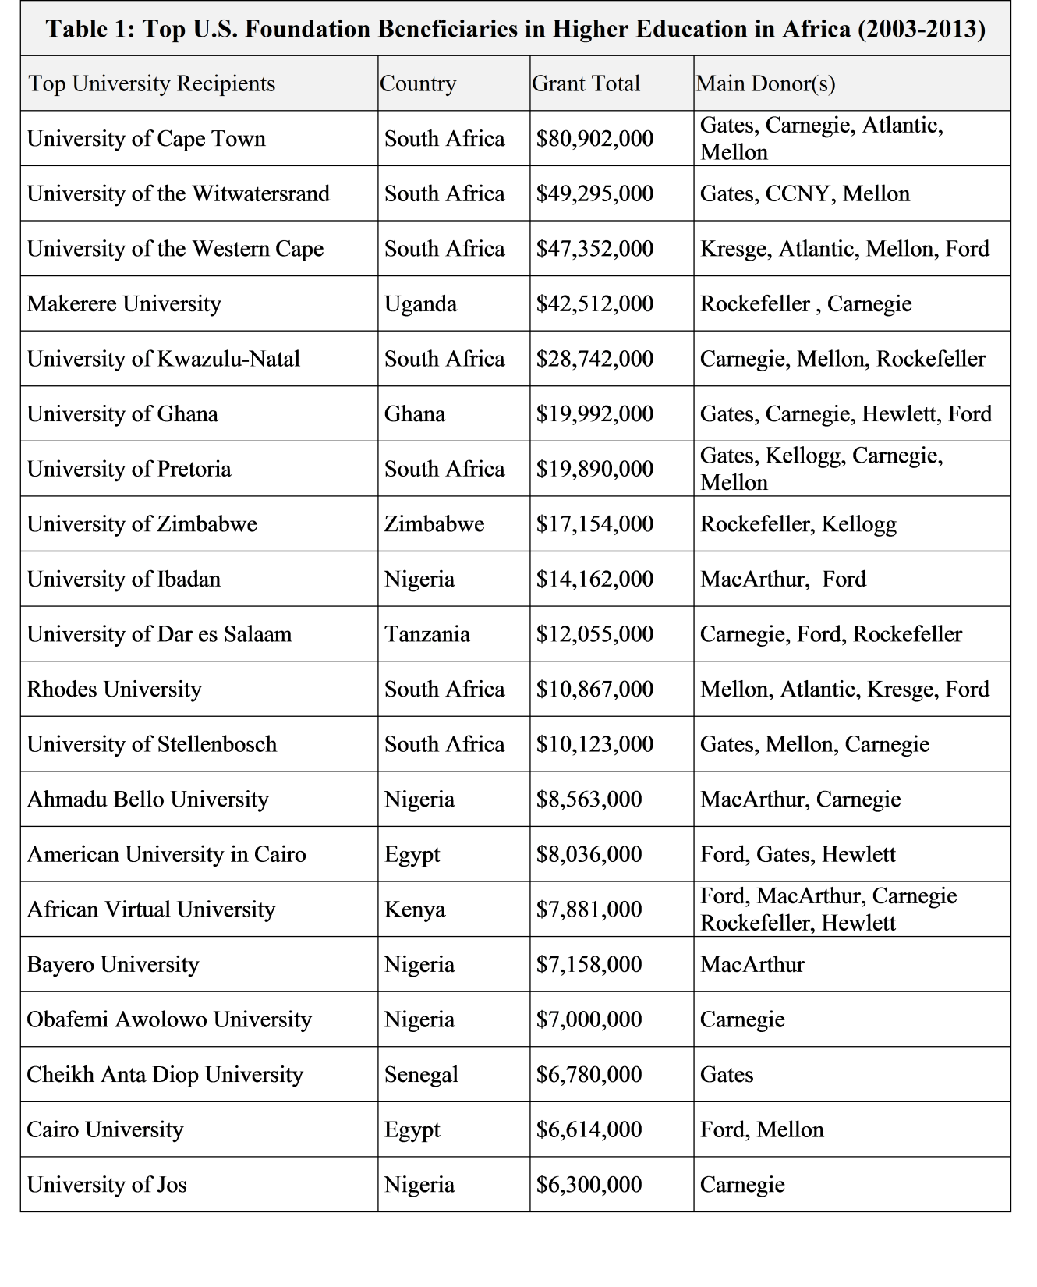

Slide 7
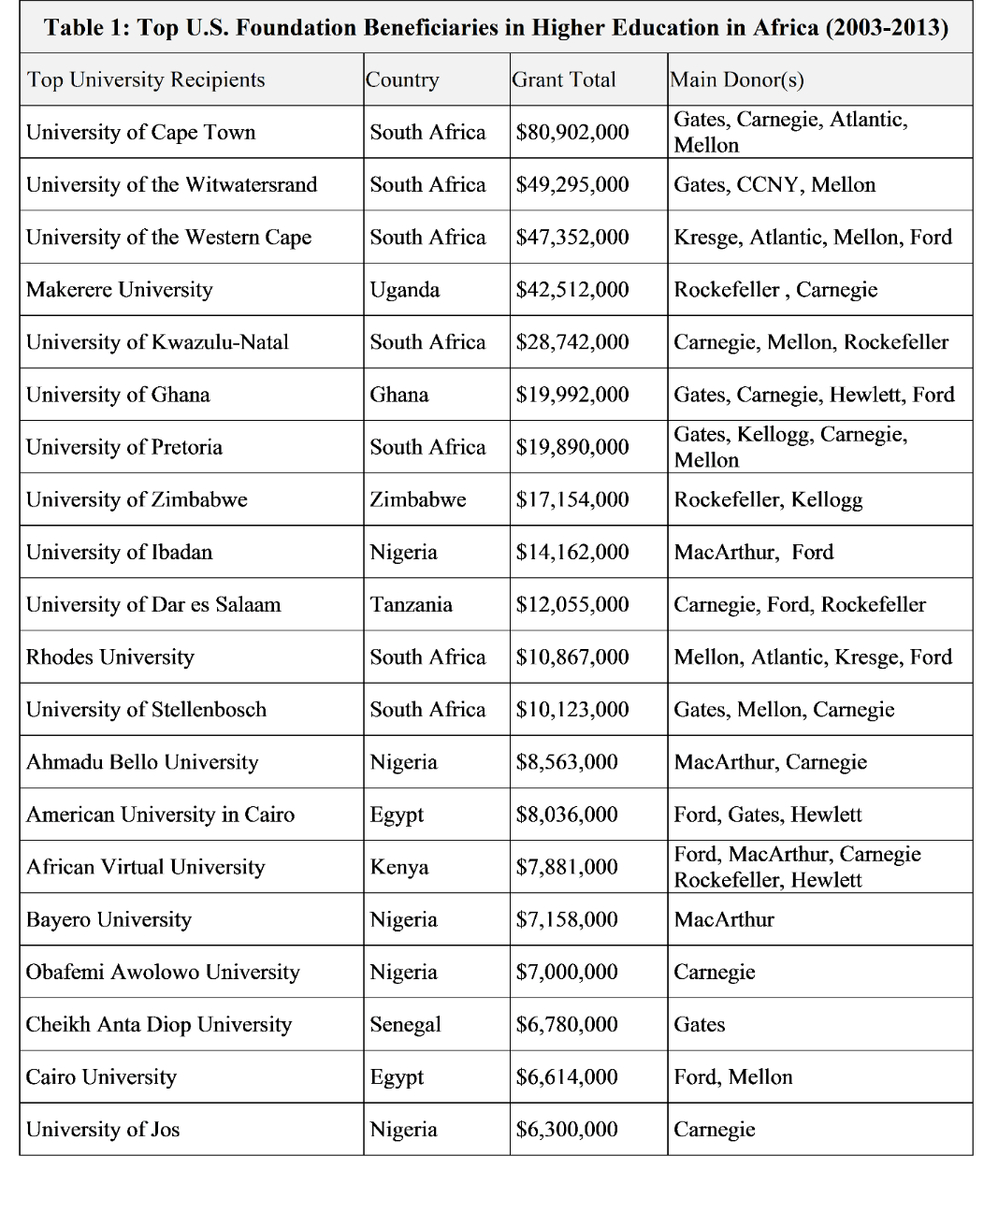
Language Bias?
Most funding from US foundations went to institutions where English is the dominant language.
Institutions in Commonwealth countries received 93.1% of the total dollar amount of U.S. foundation grants and 89.6% of all grants.
South African universities dominate the top of the list, receiving 54% of the total amount of grants
  Senegal was the only reasonably represented Francophone country.
  Mozambique was an exception for Lusophone countries.
  Egypt was the exception for Arabophone countries.

Slide 8
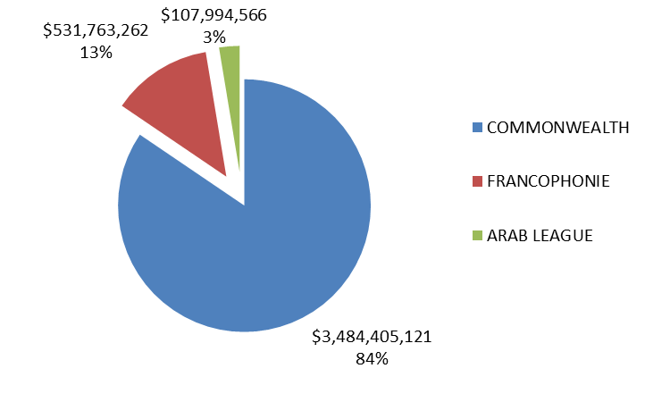
Distribution of US Foundation Grants in Africa (2003-2013)

Slide 9
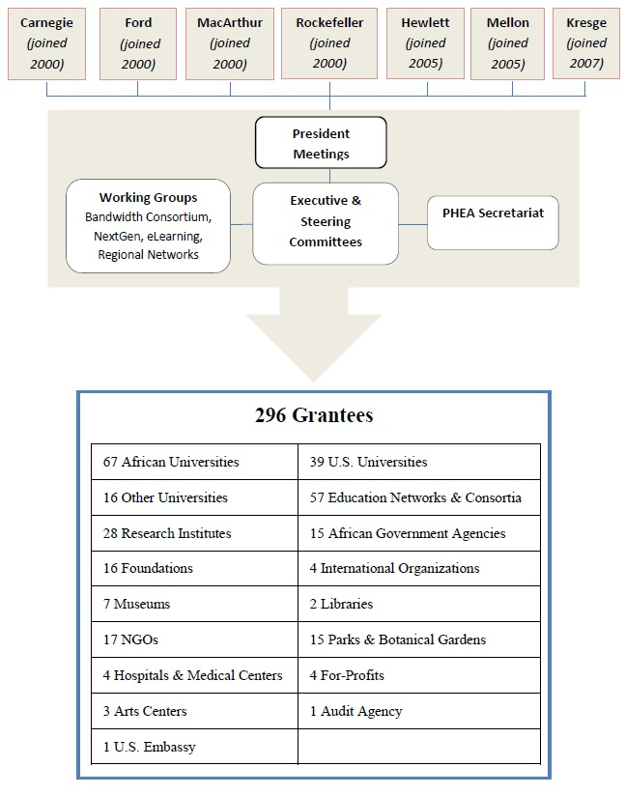

$440 Million in ten years to build capacity and support special initiatives to
  advocate for the “indispensable contribution of higher education to social and economic development”
  accelerate the “processes of comprehensive modernization and strengthening of universities in selected countries.”

Slide 10

The Leadership Role of Foundations
Foundations have helped develop:
Financial aid
Libraries
Adult education
Opportunities for minorities
New standards for courses and credits
New disciplines
Improvements in faculty compensation
Made research possible for non-wealthy faculty
Notes:
The Leadership Role of Foundations
Foundations have helped develop:
Financial aid
Libraries
Adult education
Opportunities for minorities

Slide 11
Power Asymmetry
“Is it a partnership of foundations or is it a partnership between foundations and African universities? How are we involved in defining the agenda and so forth?”
Vice-Chancellor of an African university
(incidentally he was the vice chancellor of one of the universities that were benefiting financially and otherwise from the Partnership)

Slide 12
Unequal Partners
The unequal nature of the Partnership was a concern for grantees who always questioned their role and share of participation.
Partnership remained a partnership of foundations, as several interviewees indicated.
Thus, running the risk of being perceived as dominating the agenda or imposing an American worldview on African universities was always a consideration.

Slide 13
Undesired Consequences
Universities continue to be dependent on donor funding, which perpetuates unequal partnerships between them and US foundations
This difference of status had a bearing on how the agenda was defined.
This resulted in African research agendas being modified to match available funds, and creates competition between institutions
Establishes a competitive field which puts pressure on weaker institutions.
Notes:
Universities continue to be dependent on donor funding, which perpetuates unequal partnerships between them and US foundations
This resulted in African research agendas being modified to match available funds, and creates competition between institutions

Slide 14
Engaging Africans
Hiring Africans into leadership roles within the foundations did help, and succeeded in “infusing the Partnership with an African perspective”
Experts and locals were involved in creating agendas that fit both parties
Narciso Matos, an African program director, was very influential throughout the Partnership in creating respect for African perspectives
Key Partnership foundations’ principle: to respond to priorities identified by African higher education leaders.
Notes:
Hiring Africans into leadership roles within the foundations did help, and succeeded in “infusing the Partnership with an African perspective”
Experts and locals were involved in creating agendas that fit both parties
Narciso Matos, an African program director, was very influential throughout the Partnership in creating respect for African perspectives
Key Partnership foundations’ principle: to respond to priorities identified by African higher education leaders.

Slide 15
Discussion
U.S. Foundations need to integrate the concept of equal participation into their own grant-making activities, which involves higher sensitivity to linguistic and cultural diversity.
  Through collaborative projects geared towards a multilingual society.
  Through regional cooperation as a more inclusive framework
  Through partnerships with non-English speaking institutions.
  By empowering the multilingual grant recipient in the Global South towards a more meaningful relationship.

Slide 16



Contact:
www.fabricejaumont.net

